Slide 1

Unleashing Servo Motor Control

Slide 2

LIST OF COMPONENTS:
ESP32 MICROCONTROLLER
SERVO MOTOR(SG90)
JUMPER WIRES

Slide 3
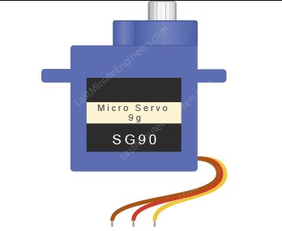
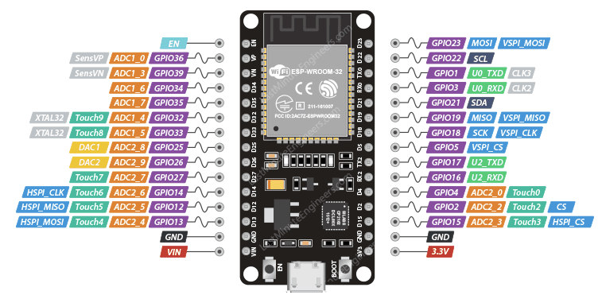
CIRCUIT DAIGRAM
CONNECT RED WIRE-VIN

Slide 4
CONNECT BROWN WIRE-GND

Slide 5
CONNECT YELLOW WIRE-D13

Slide 6
CODE:
#include <ESP32Servo.h>
Servo myservo;
const int servoPin = 13;
int angle = 0;
void setup() {
myservo.attach(servoPin);
Serial.begin(115200);
}
void loop() {
for (angle = 0; angle <= 180; angle += 1) {
myservo.write(angle);
Serial.print("Angle: ");
Serial.println(angle);
delay(1000);
delay(1000);
for (angle = 180; angle >= 0; angle -= 1) {
myservo.write(angle);
Serial.print("Angle: ");
Serial.println(angle);
delay(1000);
}
delay(1000);
}

Slide 7
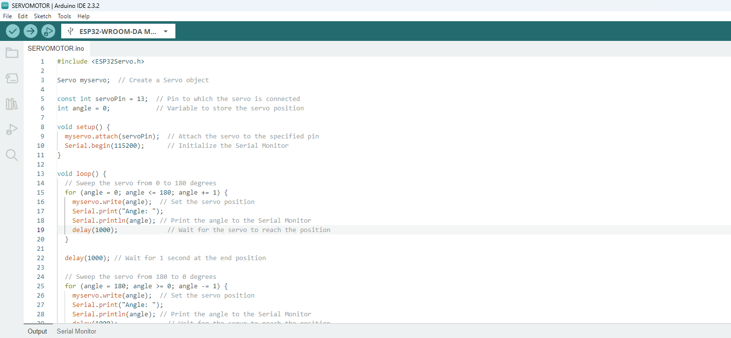
STEP 1
Copy code paste in Arduino new Sketch

Slide 8
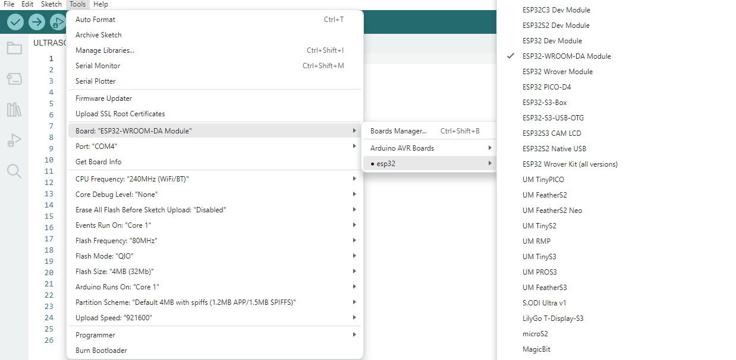
STEP 2:
Board---->esp32---->esp32-wroom-DA module

Slide 9
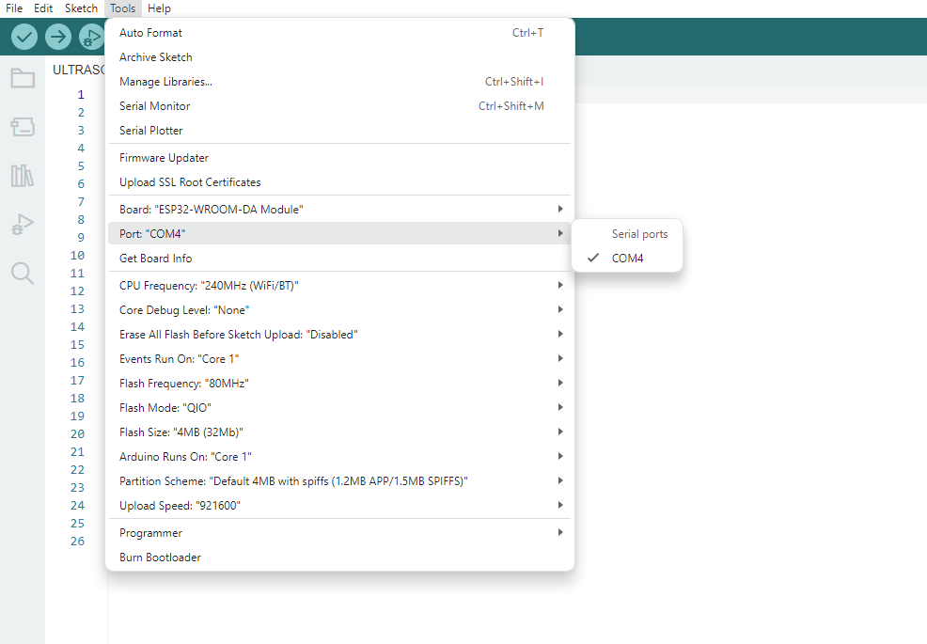
STEP 3:
Tools---->port---->select your com

Slide 10
board name automatically change to dark

Slide 11
2.After Compilation build the code to board
1.Compile the code

Slide 12
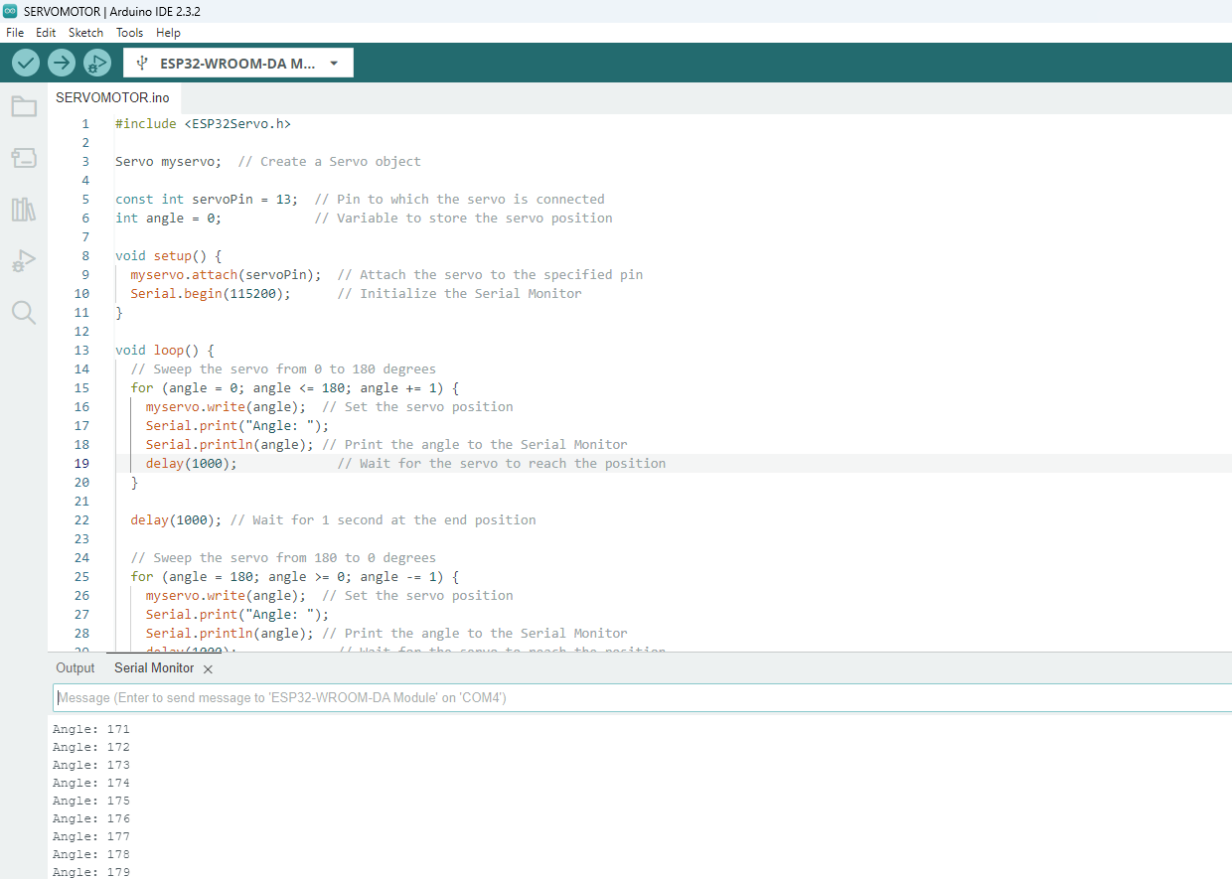
After Build the code the output like this

